Slide 1
BENEFITS OF APPLYING IMPROVEMENT SCIENCE IN HEALTHCARE SETTINGS
Balogun Stephen
MBBS, MPH, CSSGB, SMC, PMP, FISQua, Cert. Data Scientist [John Hopkins],
ISQua Ambassador; QI Expert; Lucian Leape Patient Safety Scholar

Slide 2
Our everyday struggle with improvement
The strive to get better – improve individual performance
To avoid injury and harm to every patient, at all times – quality care
To be happy with the work that we do – job satisfaction/meaning in work
To reduce the cost of healthcare per capita – Efficiency
To have safer population and prevent ill health – population health
Notes:
The last 4 points are summarized in the IHI quadruple aims – Improve care of the pat

Slide 3
What is Improvement Science
“Improvement science focuses on systematically and rigorously exploring “what works" to improve quality in healthcare and the best ways to measure and disseminate this to ensure positive change.”
Notes:
The Health Foundation’s 2011 evidence scan, the authors used the definition…

Slide 4
Why Improvement Science? - The Quality Chasm
“Between the health care that we have and the care that we could have lies not just a gap, but a chasm.”
Medical errors is the 3rd leading cause of death
Poor National Indices
Highest number of maternal deaths annually
2nd Highest under-5 mortality
Low immunization coverage rate
Notes:
Medical errors is responsible for between 44, 000 to 98, 000 deaths each year
“Every system is perfectly designed to get the results it gets.”

Slide 5
Is Improvement Science the same as Implementation Science?
 | Improvement Science | Implementation Science
Focus | Reduction of poor performance in health | Adoption of new evidence into practice
Geographical locations | Usually hospital-based | Usually within research units/universities
Outcomes of interests | Changes in indicators of clinical care | Level of compliance with implementation
Generalizability | Tends to be more local/regional | Tends to be more generalizable (national/international)
Use of explicit theoretical models | Not very important | Very – extremely important
Broadly, improvement science refers to systems-level work to improve the quality, safety, and value of health care, whereas implementation science refers to work to promote the systematic uptake of evidence-based interventions into practice.
Bogda Koczwara, Angela M. Stover, Louise Davies, Melinda M. Davis, Linda Fleisher, Shoba Ramanadhan, Florian R. Schroeck, Leah L. Zullig, David A. Chambers, and Enola Proctor. Harnessing the Synergy Between Improvement Science and Implementation Science in Cancer: A Call to Action

Slide 6
Healthcare Assumptions
A person’s health is not (easily?) outsourceable.
Healthcare is fundamentally a service, “made” with a logic which involves two parties.
Coproduction is fundamental to service creation, development
Value creation and its study requires models that are connected to assumptions 1 -3 (above)
Notes:
Paul Batalden et al. Coproduction of healthcare service

Slide 7
Levels of Improvement Science
Individual
Health Systems
Organizations
Clinical teams

Slide 8
Scenario - 1
A hospital ward/room with five beds
Has 7 Wall sockets but only 2 are functional
All the beds are occupied and each of the patients have electronic gadgets to plug
It is about 7:00PM and everywhere has become dark
A patient tripped over one of the cables and fall while trying to use the convenience
Hit the face over the bedframe and sustained deep laceration

Slide 9
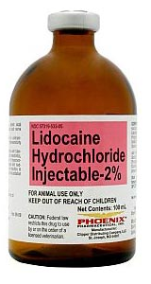
Scenario - 2
An emergency surgical operation (e.g., ruptured ectopic pregnancy) in a remote facility – available GA is Ketamine
Both Ketamine and lidocaine bottles available are in brown bottles, about the same size.
The attending staff administering the anaesthesia gives lidocaine intravenously instead of ketamine

Slide 10
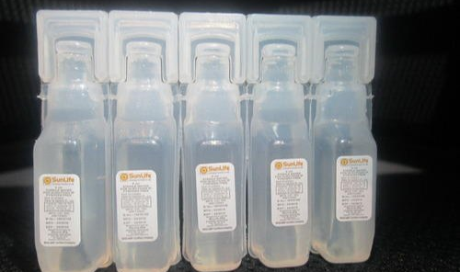
Scenario - 3
A 2-year-old child needs a powdered medication constituted for intravenous administration
The healthcare worker to administer is not familiar with plastic diazepam and assumes it to be sterile water
Uses the diazepam (5ml) to constitute the injection and gave intravenously

Slide 11
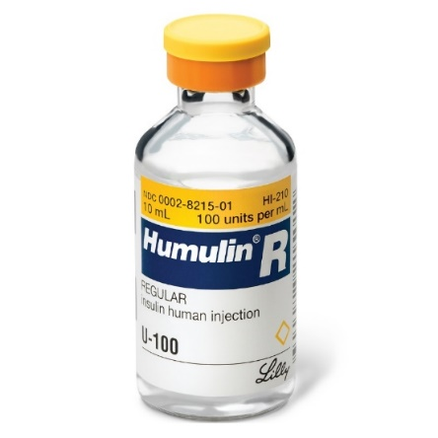
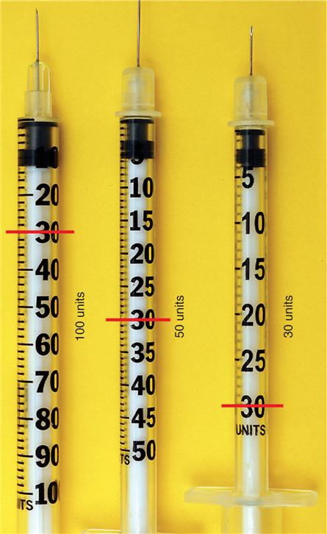
Scenario -4
An elderly woman on insulin injection 30IU
New set of insulin syringes were procured. The new syringes were calibrated in mL.
Over the next 24 hours, clients blood sugar was uncontrolled

Slide 12
Improvement Science focuses on not the “who” but the “why”?
Why did the harm occur?
Why is the outcome currently as it is?
“Every System is perfectly designed to get the results it gets.”
- Edward Deming

Slide 13
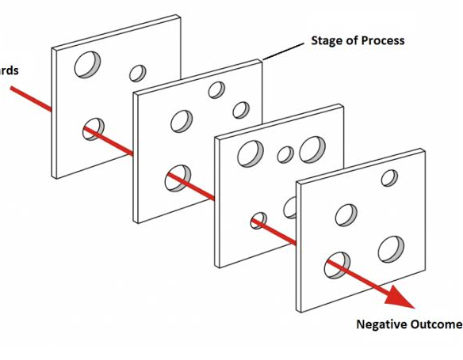
Poor Quality? Think systems failure
Organizational and Management level: legislations, policies, recruitments, structures
Preconditions level: employee motivation, knowledge, training
Unsafe acts level: personal fault, adherence to rules

Slide 14
What Quality Improvement is not…
Forcing people to work harder, faster, or safer
Blaming people for failure of systems
A one-time event or intervention BUT a cyclical, continuous process.
Research (although it involves the collection and analysis of data)
Looking for new knowledge, rather it is ‘bringing new knowledge into daily practices’.

Slide 15
Improvement Science, why should I bother?
“Everyone is employed to do two things: doing the job and improving the work”
It benefits you, in the short, intermediate and long-term

Slide 16
Dimensions of Quality
Safe: avoiding injuries to patients from care that is intended to help them
Timely: reducing waits and sometimes harmful delays for patients and providers
Effective: providing the appropriate level of services based on scientific knowledge
Efficient: avoiding waste, including waste of equipment, supplies, ideas, an energy
Equitable: providing care that does not vary in quality because of personal characteristics
Patient-centered: providing care that is respectful of and responsive to individual patients
Notes:
WHO modified “timely” to “accessible” and added “integrated”.

Slide 17
Quality Framework: The Donabedian Model
Structure
Physical facility
Equipment/technology
Human resources
Education
Remuneration
Process
Diagnosis
Treatment
Appropriateness
Process of care
Outcomes
Mortality
Morbidity
Cost
Quality of life
Patients experience

Slide 18
Need Improvement? Apply Systems Thinking
Notes:
Appreciation of the system: What is the whole system that you’re trying to manage? How do the different parts interact with and rely on one another?
Understand Variation: What is the variation in results trying to tell you about the system? Why did something go wrong? Why are results so poor? How can you repeat successful results?
Theory of knowledge: What are your predictions about the system’s performance? What are the theories that form the basis for these predictions?
Understand Human behaviour: What are the important interactions among people in the system? How do people in a system react to change? What motivates people to act as they do?

Slide 19
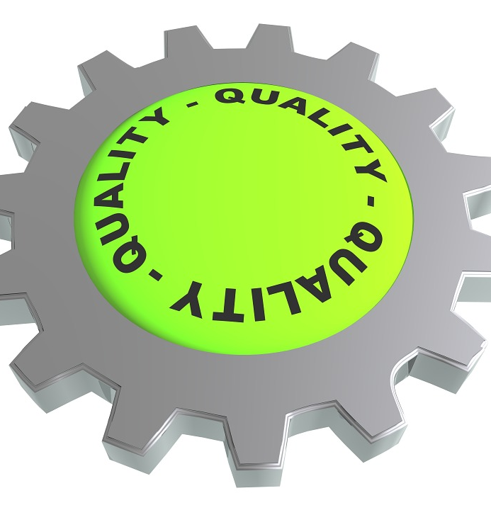
Improvement Methods
Improvement Model for Improvement
The Six Sigma
Lean
Scrum
Kanban

Slide 20
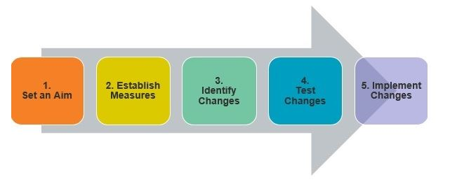
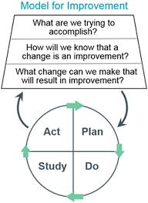
The Model for Improvement

Slide 21
The Model for Improvement - Aim
Specific – be particular, not vague
Measurable – can be measured numerically
Attainable (Actionable) – can be achieved
Realistic (Relevant) – feasible
Time-bound – have a deadline
We will be reducing the waiting time for patients attending the Medical Outpatient Department Clinic from an average of 1 hour per patient to not more than 15 minutes per patient within 6 months of the project
We will be reducing the number of days of hospital admissions from 7 days to not more than 3 days by December 2021

Slide 22
The Model for Improvement - Aim
Specific – be particular, not vague
Measurable – can be measured numerically
Attainable (Actionable) – can be achieved
Realistic (Relevant) – feasible
Time-bound – have a deadline
Not Specific!!!
We will be reducing the waiting time for patients attending the Medical Outpatient Department Clinic from an average of 1 hour per patient to not more than 15 minutes per patient within 6 months of the project
We will be reducing the number of days of hospital admissions from 7 days to not more than 3 days by December 2021

Slide 23
The Model for Improvement - Measures
Families of measures
Outcome measures – e.g. Weight (in Kg)
Process measures –
150 minutes activity per week
Reduce intake of soft drinks to not more than 2 bottles per week
Reduce feeding frequency to twice per day
Reduce food quantity per meal to not more than 100g
Balancing measures
Sores/injuries while exercising
Ulcer symptoms
Lateness to work (as a result of exercise)
AIM: Reduce weight from 90Kg to not more than 75Kg by December 2021

Slide 24
The Model for Improvement - Changes
Conduct Root-cause analysis
Identify possible changes to be made
Prioritize

Slide 25
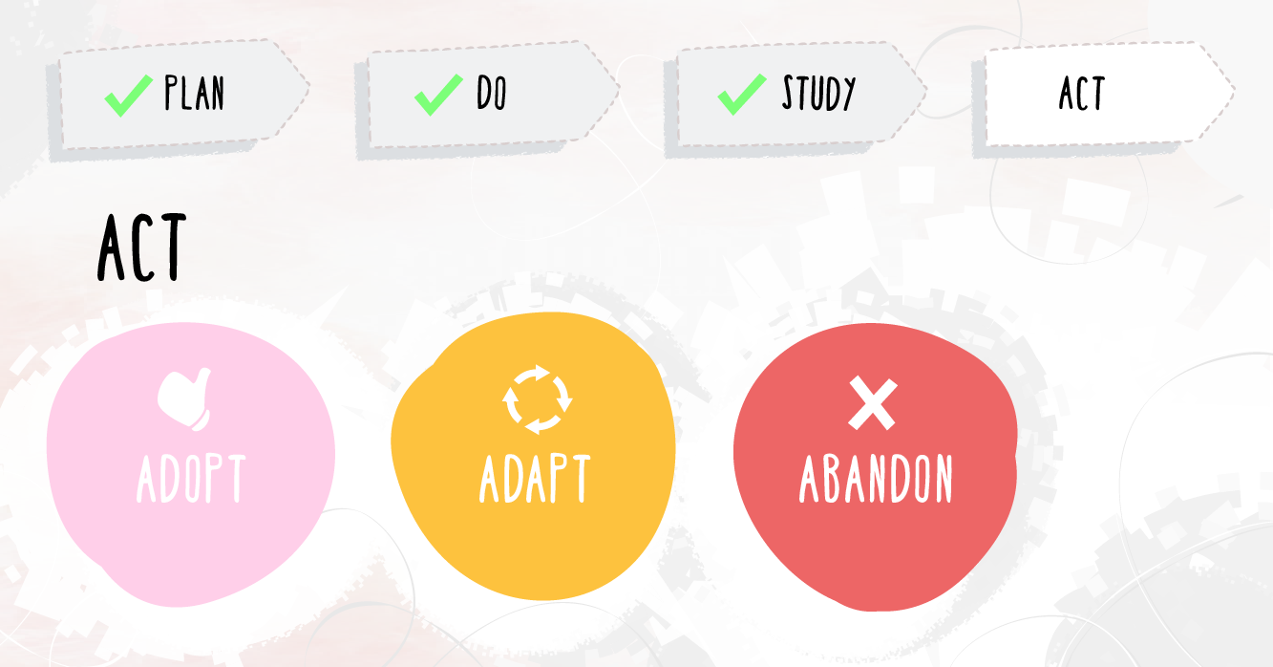
The Model for Improvement - Test
Adopt – standardize/hold the gains
Adapt - modify
Abandon – repeat cycle/try again differently

Slide 26
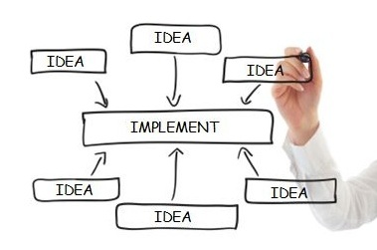
The Model for Improvement - Implement
Scale-up adoption

Slide 27
The Model for Improvement - Sustain
Control
Wrap-up project
Plan for sustenance
Routinize

Slide 28
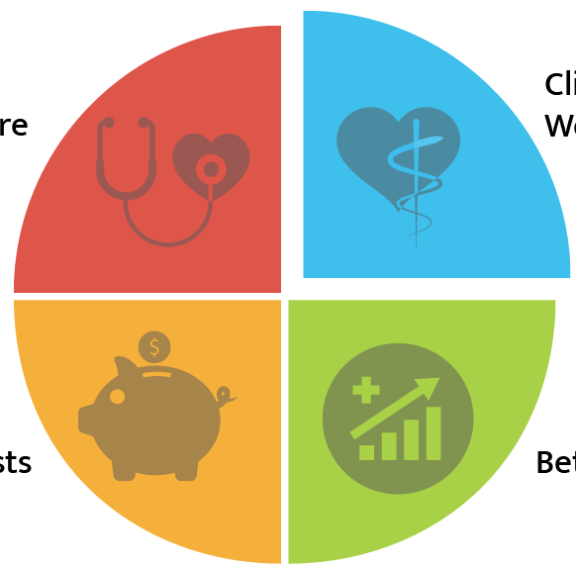
Benefits of Quality Improvement
Improved Patient Care
Care team Well-being
The Patients
The Clinical Team
The Healthcare organization
The community
The nation
Better outcome
Lower Cost
The Quadruple Aim

Slide 29
Benefits of Quality Improvement – the patients
Reduced length of hospital stay
Reduced occurrence of complications/adverse events
Eliminates unnecessary cost
Increased patient satisfaction

Slide 30
Benefits of Quality Improvement – the Clinical team
Reduced loss of man-hours attending to complications/re-work
Increased job satisfaction
Recognition
Career growth

Slide 31
Benefits of Quality Improvement – the Organization
Cost effectiveness
Staff retention
Recognition
Growth
Notes:
Quality, they say is not cheap. But also, quality does not necessarily have to be expensive. The safest hospitals/countries are not necessarily the ones with the highest per capital on health. Quality is about using what you have to become what you need, to achieve the results that you desire.

Slide 32
Benefits of Quality Improvement – the Community
Reduction in loss of productive man-hours
Economic growth
Improved healthcare indices

Slide 33
Examples of Application of Improvement Science
Reduction in PPPH incidence
Improved experience of maternity care
Improved uptake of INH among clients on ART
Improved retention of clients on ART
Building a community of QI

Slide 34
Recognitions
Best poster award – ISQua conference 2019
Runner-up, first ISQua International QI Competition – 2019
Sponsored invitation, the 5th Global Ministerial Summit on Patient Safety – 2020
Recognized Quality Improvement Expert, ISQua – 2020
Membership, WHO GLLUHC and GPSN
Contributions, 2 WHO handbooks
National Handbook of Quality Policy and Strategies (NQPS)
Global Patient Safety Action Plan (draft)
Notes:
IHI building a community of QI: http://www.ihi.org/communities/blogs/africa-building-a-community-of-qi-and-patient-safety-champions?utm_campaign=tw&utm_medium=email&_hsmi=111272668&_hsenc=p2ANqtz--q_wMoL11dHa-Y4ZxM2CjyeTuogK52xngdkCIPRe_XQaATakvQhpfdwlHyZ_HUX52NnuyHp-lyIjLMwTTQWSmsBXV0Rw&utm_content=110865373&utm_source=hs_email

Slide 35
Call to action: Start now
“Start where you are…
Start with doubt
Start with hands shaking
Start with voice trembling but start
Start and don’t stop
Start where you are,
With what you have
Just … start”
- Ijeoma Umebinyou
Notes:
“Improvements is just begging to happen because the gaps are simply so huge!”

